Slide 1

Home Rental Management System
Submitted To
Prof. Dr. Kamruddin Nur
Professor, Dept. of Computer Science

Slide 2
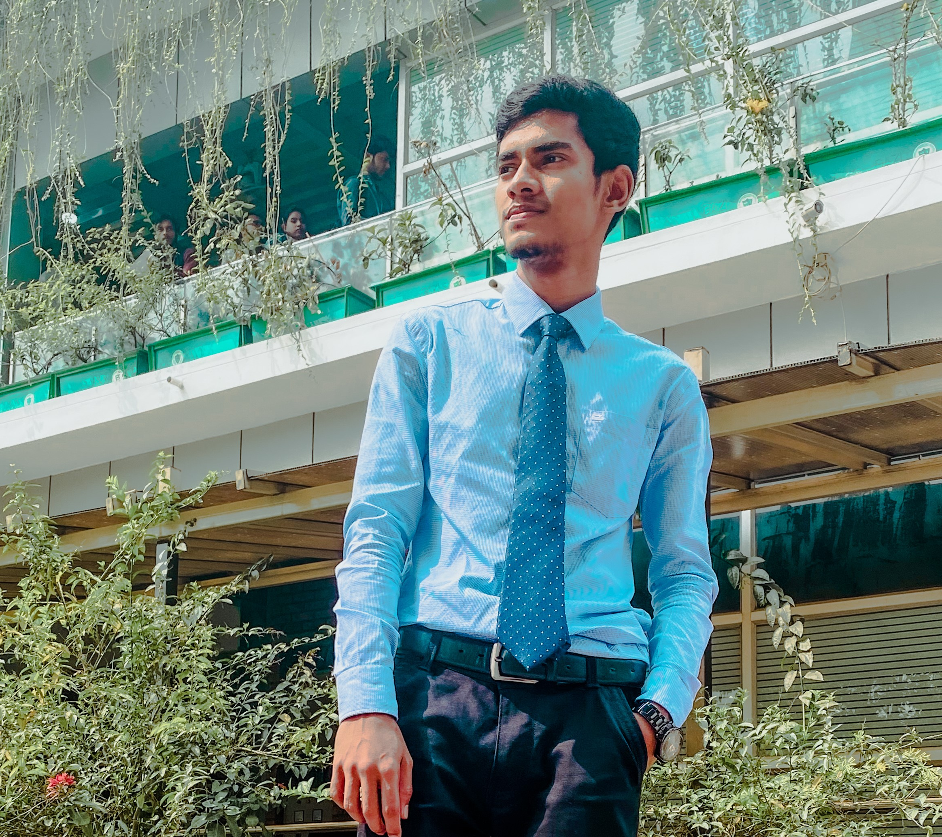

Meet our team
Nayeem Abdul Qaiyum
Id : 20-43581-1
Sadia Islam Shafina
Id : 20-43539-1

Slide 3



Our project management tools name is "Monday.com".

Slide 4
Agenda
Introduction
Objectives
Project Deliverable
Project Schedule
Project Milestones
Budget Estimation
Risk Analysis
Resource Management & Quality Assurance
Conclusion
Presentation Title

Slide 5

Introduction
A home rental management system is a software application designed to help landlords, property managers, and rental agents manage the process of renting out properties. It provides a centralized platform for managing all aspects of the rental process.

Slide 6
Objectives
Software program must have tenant administration, rent collection, maintenance, and financial reporting.
Specification of software application's technical requirements.
Designing a user-friendly interface for administrators and renters.
Provide users with support and training to use software efficiently.

Slide 7
Project Deliverable
Project Management Plan
Business Requirements Document
Software System
Test Plan
User Manual
Maintenance Manual

Slide 8
Schedule
Jan(25-28 Feb) 2023
Jul(1-31) 2023
Requirements Gathering Phase
Testing & Maintenance Phase
Jan(1-21) 2023
Apr(5-30 Jun) 2023
Planning Phase
Mar(1-31) 2023
Design Phase
Development Phase

Slide 9
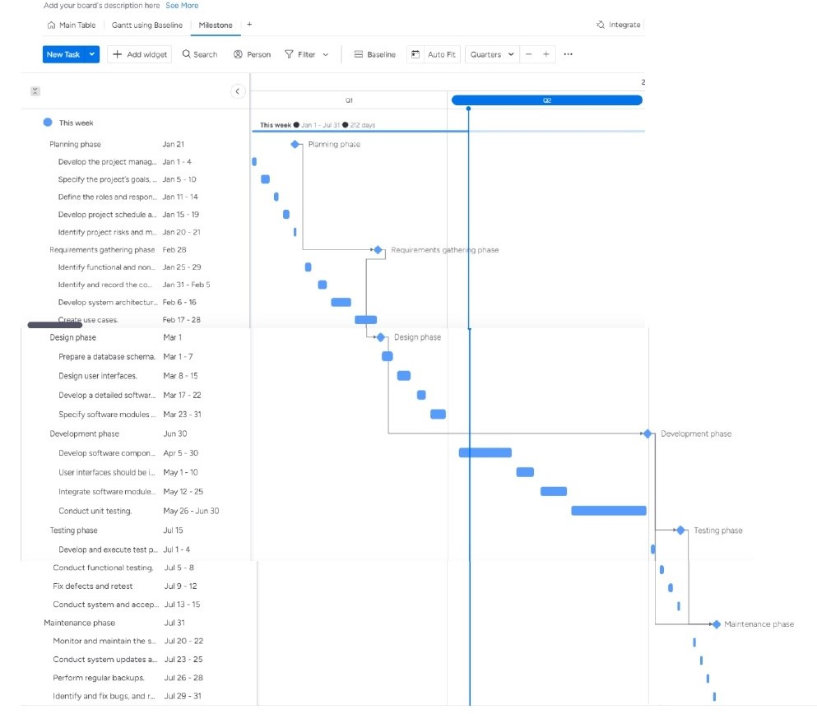
Project Milestones

Slide 10
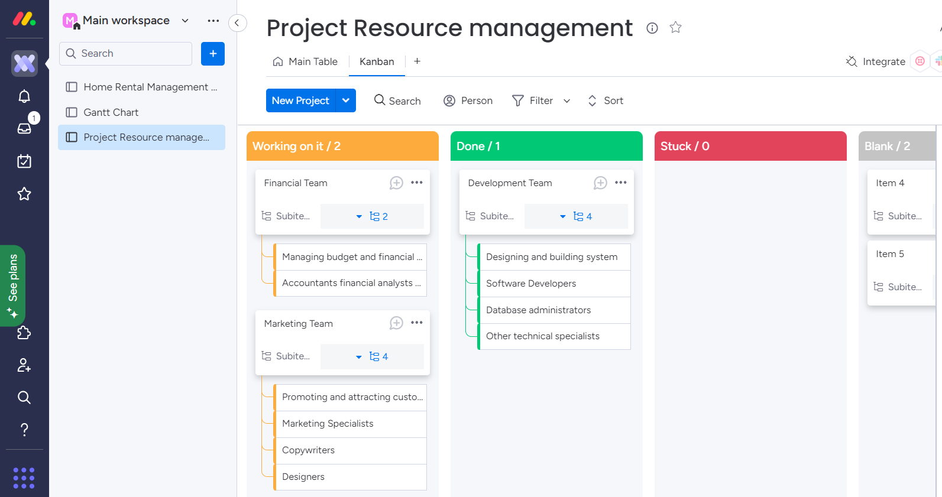
Resource Management

Slide 11
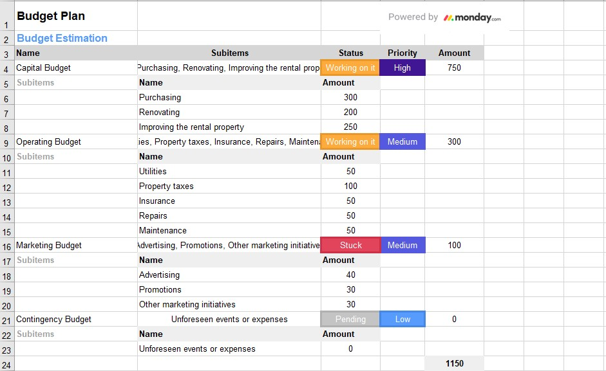
Budget Estimation
We divided our budget estimation into various categories :
Capital Budget
Operating Budget
Marketing Budget
Contingency Budget

Slide 12
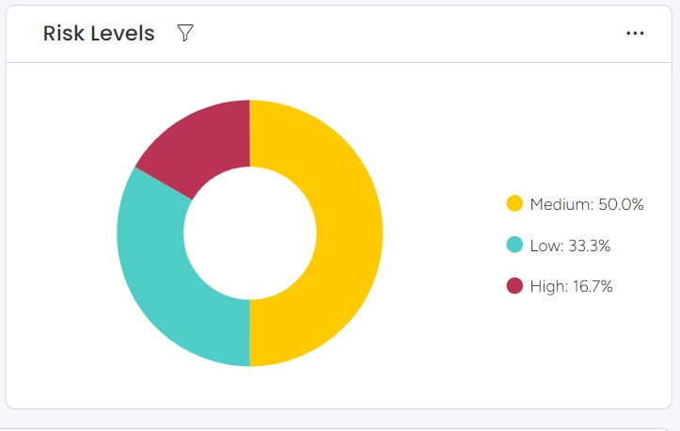
Risk Analysis
There are 6 types of risks :
Lack of clear communication
Poor planning
Inaccurate budgeting
Inadequate staffing
Lack of expertise
Poor quality control

Slide 13
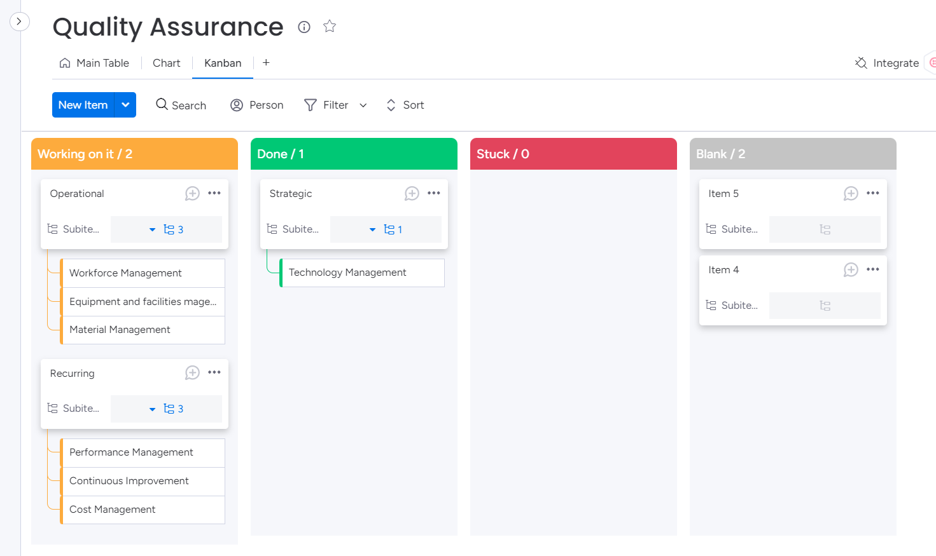
Quality Assurance

Slide 14
“A home rental management system is an effective tool to simplify the procedures needed to rent out properties, reduce mistakes, save time and money, and provide valuable information to help property owners improve their choices and business plans.”
Conclusion

Slide 15




Thank you
Nayeem Abdul Qaiyum(qaiyum.1416@gmail.com)
Sadia Islam Shafina(sishafina@gmail.com)

